Slide 1

Science 6
Week 4 – Day 1

Slide 2
Objectives: Describe techniques in separating mixtures such as decantation, evaporation, filtering, sieving and using magnet.

Slide 3
Separating mixtures through Decantation

Slide 4
Let’s study the given sample materials. Identify the type of mixtures for each sample.
1. coffee dissolved in water
2. Milk
3. paper clips and pins
4. halo-halo
5. Salt solution

Slide 5
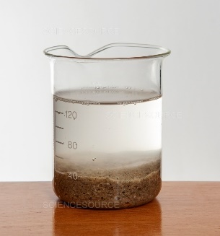
Look at the picture. What can you see?

Slide 6
Processing question:
1. How are you going to separate the mixture?

Slide 7
1. The class will be divided into 3 groups.
2. Each group will choose a leader and a reporter.
3. Each group will be given an activity sheet.
4. The activity card serves as your guide on the activity that you are going to perform.
5. All the members in the group must work as a team.
6. After the activity write the results of your activity on the activity sheet.
7. The leader will present the results/findings.

Slide 8
Activity:
Title: Separating mixtures through Decantation
II. Materials: sand, clear water, 2 beakers/glasses
III. Procedures:
1. Check the apparatus to be used.
2. Put the sand in water.
Let the mixture settler for 10 minutes.
3. Slowly pour the water to another container without disturbing the sand at the bottom.

Slide 9
IV. Question:
1. What are your observations when you pour the water to another container?

Slide 10
Decantation is a technique used in separating a less-dense substance from a dense one. In the process of decantation, the mixture is left undisturbed. When the components are separated, the less dense substance could be removed by scooping using a spoon or it can be removed by slowly
pouring out the less-dense substance

Slide 11
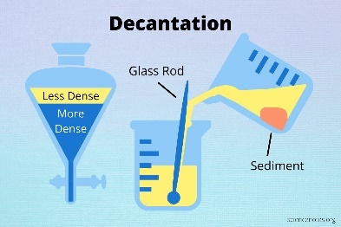
Oil in water could be removed using the decantation technique.

Slide 12
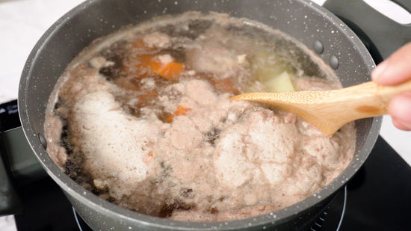
The fats that float in your sinigang could be removed by decantation or scooping.

Slide 13
Give 3 examples of mixture that can be separated using decantation.

Slide 14
How can you apply decantation method in everyday living?

Slide 15
Summarize the lesson by describing the decantation process.

Slide 16
Read the following sentences. Write TRUE if the statement is correct and FALSE if it is not.
I. Decantation is a technique used in separating a less dense substance from a denser one.
2. In the process of decantation, the mixture is less disturbed.

Slide 17
3. We used decantation method in separating the fruit salad mixtures.
4. Oil in water could be removed using the decantation technique.
5. Decantation is used in removing oil or gasoline from an oil
spill.

Slide 18
Make a simple illustration showing decantation.

Slide 19
Science 6
Week 4 – Day 2

Slide 20
Objectives: Describe techniques in separating mixtures such as decantation, evaporation, filtering, sieving and using magnet.

Slide 21
Separating mixtures through Decantation

Slide 22
What again is decantation?

Slide 23
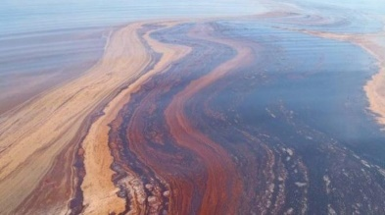
An oil spill is one of the environmental problems that occur in the bodies of water. How can decantation be useful in this kind of situation.

Slide 24
For today, we will learn how decantation can be beneficial in our community.

Slide 25
1. The class will be divided into 5 groups.
2. Each group need to prepare a situation in their community that shows the application of decantation.
3. A member will explain how decantation can be beneficial

Slide 26
Presentation of output.

Slide 27
Study the following mixtures. Tell whether they can be separated through decantation methods. Write YES or NO on your paper.
1. gasoline in water
2. arroz caldo soup
3. spaghetti
4. sinigang with floating fats
5. ice cream
6. fruit salad
7. oil in water
8. lugaw
9. batchoy
10. tinolang manok

Slide 28
What chores at home decantation can be applied?

Slide 29
Complete the paragraph by supplying the missing word in the blank.
I learned that…
Decantation is a technique used in separating ______________ from a ______________. In the process of ______________, the mixtures is left undisturbed. When the ______________ the less dense substance could be removed by scooping using a spoon or it can be removed by slowly ____________.

Slide 30
Read the following questions. Write the letter of the correct answer.
1. What method is used to separate a less dense substance from a denser one?
A. Decantation
B. Evaporation
C. Filtration

Slide 31
2. Which mixture can be separated through decantation?
A. Mixed nuts
B. Sugar and salt
C. Water and oil
3. What will happen to mud when you mix it with water?
A. It will float.
B. It will evaporate.
C. It will sink.

Slide 32
4. In the process of decantation, the mixture is left _______.
A. behind
B. removed
C. Undisturbed
5. What method is used to clean rice grains before cooking it?
A. decantation
B. picking
C. filtration

Slide 33
In a grade 6 science class a group of students would like to separate salt from water. What method they will use to separate the mixture?

Slide 34
Science 6
Week 4 – Day 3

Slide 35
Objectives: Describe techniques in separating mixtures such as decantation, evaporation, filtering, sieving and using magnet.

Slide 36
Separating mixtures through Evaporation

Slide 37
Based on your homework, what method will you use to separate salt from water? Explain your answer.

Slide 38
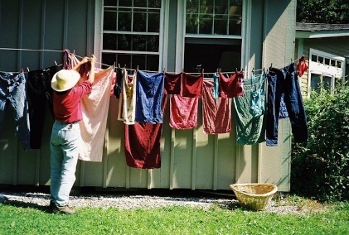
Analyze the picture below.

Slide 39
Ask the following questions:
1. What is happening in the picture?
2. What is the main purpose of evaporation as a process in the preparation of this activity?

Slide 40
1. The class will be divided into 3 groups.
2. Each group will choose a leader and a reporter.
3. Each group will be given an activity sheet.
4. The activity card serves as your guide on the activity that you are going to perform.
5. All the members in the group must work as a team.
6. After the activity write the results of your activity on the activity sheet.
7. The leader will present the results/findings.

Slide 41
Activity
Title: Evaporate: Let’s evaporate!
II. Materials: pinch of salt, alcohol lamp/hot plate or gas burner, water spoon, pan
Caution: Make sure to avoid contact with the hot plate/gas burner or the pan when hot to avoid getting burned.

Slide 42
Procedures:
1. Put 1 spoon of salt in a pan with 1 glass of water.
2. Stir the solution and cover once done.
3. Place pan at the gas burner and let it boil until no water is left in the pan.

Slide 43
IV. Question:
1. What happens to the salt solution after the water evaporated?

Slide 44
Evaporation is a process of separating mixtures which involves heating the solution until the solvent evaporates leaving behind the solid residue.

Slide 45
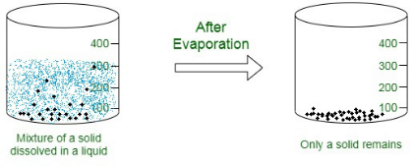
Heat being the main component in this process separates the mixtures of solid from a liquid. As liquid goes in the air in a form of gas when heated, changing liquid to gas as an example of physical
change.

Slide 46
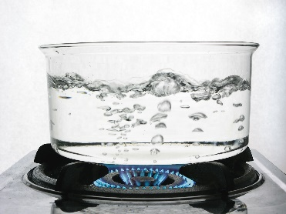
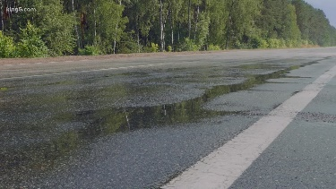
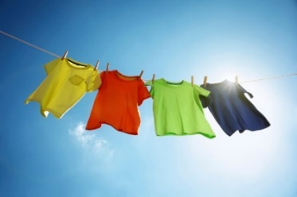
Some examples of evaporation are boiling water, drying clothes, and drying of wet roads after heavy.

Slide 47
Illustrate a situation where evaporation process was observed.

Slide 48
What chores at home evaporation can be applied?

Slide 49
Complete the following ideas.
I learned that…
Evaporation is a process of separating mixtures which involves ____________
until the solvent _____________
leaving behind the ___________

Slide 50
Read the following questions. Write the letter of the correct answer.
1. What method is used to obtain salt from sea water?
a. decantation
b. sedimentation
c. evaporation
d. filtering

Slide 51
2. Which of the following examples undergo evaporation process?
a. a pail of water under the heat of the sun
b. brushing your teeth after meal
c. ironing clothes every weekend
d. listening to the radio

Slide 52
3. It is the main factor that causes evaporation process in separating mixtures.
a. water
b. heat
c. smoke
d. light

Slide 53
4. Princess accidentally spill a glass of water in the salt container and she is thinking with of a solution on how she's going to recover salt from water,
What will Princess do to return the salt to its original phase?
a. She will wrap it with newspaper tightly
b. She will throw it away in the waste can
c. She will hide it in a dark corner
d. She will boil the solution

Slide 54
5. While boiling water in a kettle, Gwayne noticed that there are smoke coming from the spout of a kettle. He asked his mother, "Why did the smoke rise upward"? What do think will be the mother's answer?
a. because the water reached its cooling point
b. because the water reached its boiling point
c. because the water is heated and became water vapor
d. because the water is freezing

Slide 55
Direction: Put a ✓ before the number if the technique used is and X if not.
1. water cycle
2. using cell phone
3. pulling a chair
4. drying of hair using hair dryer
5. boiling camote

Slide 56
Science 6
Week 4 – Day 4

Slide 57
Objectives: Describe techniques in separating mixtures such as decantation, evaporation, filtering, sieving and using magnet.

Slide 58
Separating mixtures through Evaporation

Slide 59
Checking of assignment.

Slide 60
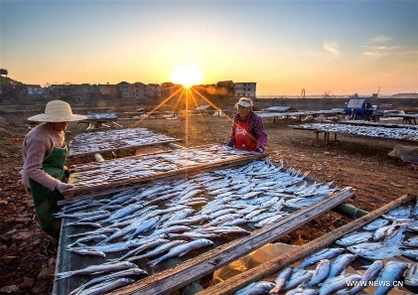
Who among you eat dried fish (tuyo)? How do you think dried fish was processed?

Slide 61
For today, we will learn how evaporation can be beneficial in our community.

Slide 62
1. The class will be divided into 5 groups.
2. Each group need to prepare a situation in their community that shows the application of evaporation.
3. A member will explain how evaporation can be beneficial.

Slide 63
Presentation of output.

Slide 64
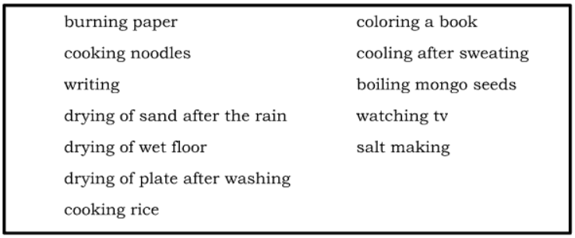
Direction: Read the conditions stated in the box. Pick out those that undergo evaporation process.

Slide 65
Why it is important to know the process of evaporation?

Slide 66
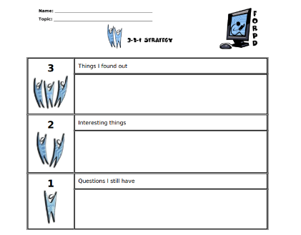
Let’s answer this 3-2-1 exit card.

Slide 67
Read the following questions. Write the letter of the correct answer.
1. Lester had noticed that the amount of water in a container with a plant becomes less as the days. What do think is the reason of decreasing amount of water in a container?
a. Some insects sipped the water.
b. Water in the container was not changed.
c. Water evaporated because of heat.
d. The plant has a stem.

Slide 68
2. Which of these examples shows evaporation process as technique of separating mixtures?
a. drying of water on the table
b. flooding of water in the river
c. cooling of water in the refrigerator

Slide 69
3, What technique will Jocelyn use if she wants to separate salt mixed with water in a container?
a. filtering
b. evaporation
c. picking
d. sedimentation

Slide 70
4. In evaporation process, liquid becomes _________when heated.
a. solid
b. liquid
c. plasma
d. vapor

Slide 71
5. It is a process of separating mixtures which involves heating leaving the solid residue in a container.
a. evaporation
b. precipitation
c. distillation
d. sedimentation

Slide 72
Review for the weekly assessment tomorrow.

Slide 73
Science 6
Week 4 – Day 5

Slide 74
Objectives: Describe techniques in separating mixtures such as decantation, evaporation, filtering, sieving and using magnet.

Slide 75
Weekly Test

Slide 76
Recall their past lessons.
Preparation of test materials.

Slide 77
Now that you have learned decantation and evaporation, let’s assess your understanding by taking the quiz.

Slide 78
Setting of standards in taking the test

Slide 79
Distributes test materials to the pupils.

Slide 80
Answering of test items

Slide 81
Checking and recording of test results

Slide 82
Test item analysis.

